Slide 1

The Impending Conflict
Revelation 13, 14
The Great Controversy Ch. 35-36
Lesson 11, 2nd Quarter 2024

Slide 2
¹⁷ Sanctify them through thy truth: thy word is truth.
Memory Text: John 17:17

Slide 3
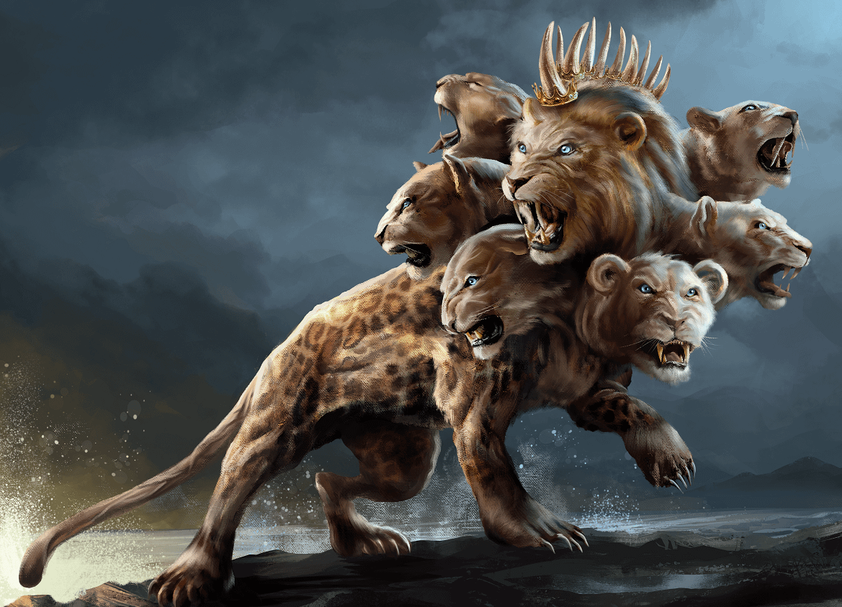
a review: REVELATION 13:1-18
13 And I stood upon the sand of the sea, and saw a beast rise up out of the sea, having seven heads and ten horns, and upon his horns ten crowns, and upon his heads the name of blasphemy.
Revelation’s symbology:
Sea--Peoples/Nations/Tongues
Horns—Political Powers

Slide 4
a review: REVELATION 13:2-18
2 And the beast which I saw was like unto a leopard, and his feet were as the feet of a bear, and his mouth as the mouth of a lion: and the dragon gave him his power, and his seat, and great authority.
Of the beasts seen by Daniel in Daniel 7, the first was like a lion, the second like a bear, the third like a leopard. The power represented by this beast seems to possess characteristics prominent in the kingdoms of Babylon, Persia, and Greece.

Slide 5
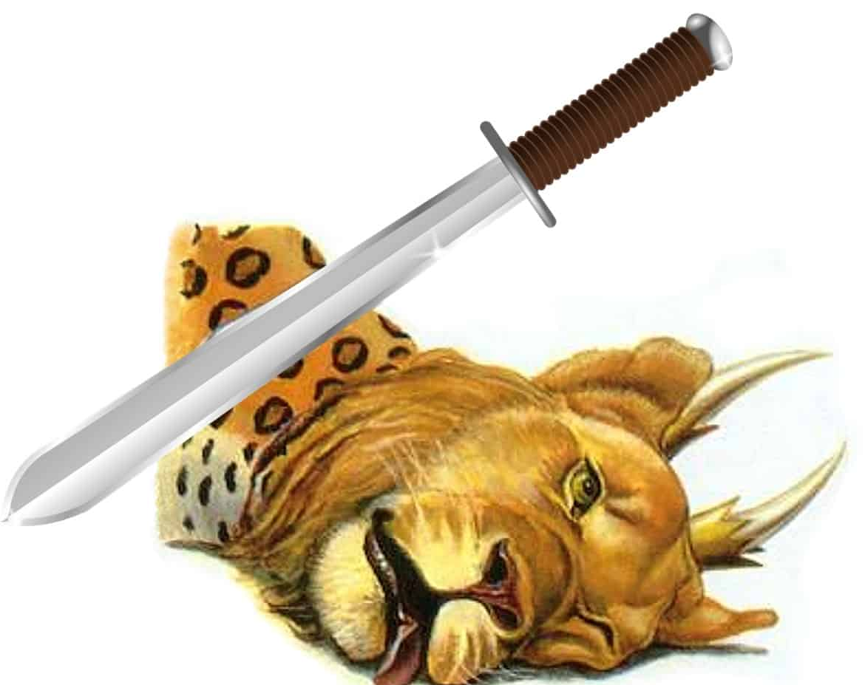
a review: REVELATION 13:3-18
3 And I saw one of his heads as it were wounded to death; and his deadly wound was healed: and all the world wondered after the beast.

Slide 6
Identifying the BEAST: Revelation and Daniel
The beast of Rev. 13 had a “mouth speaking great things and blasphemies” (v. 5);
The beast was “to continue forty and two months” (Rev. 13:5);
The beast was “to make war with the saints, and to overcome them” (Rev. 13:7);
the little horn of Dan. 7 also had a “mouth speaking great things” (v. 8).
the horn was to continue “until a time and times and the dividing of time” (Dan. 7:25).
the horn “made war with the saints, and prevailed against them” (Dan. 7:21).

Slide 7
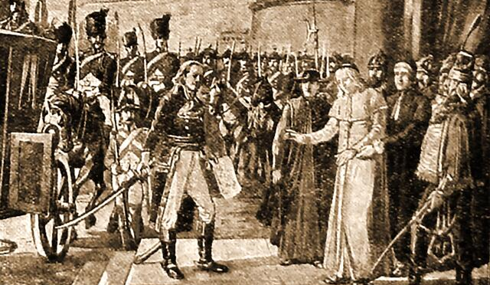
Pope Pius VI being arrested by French General Berthier in 1798… Pope Pius VI would die in captivity.

Slide 8
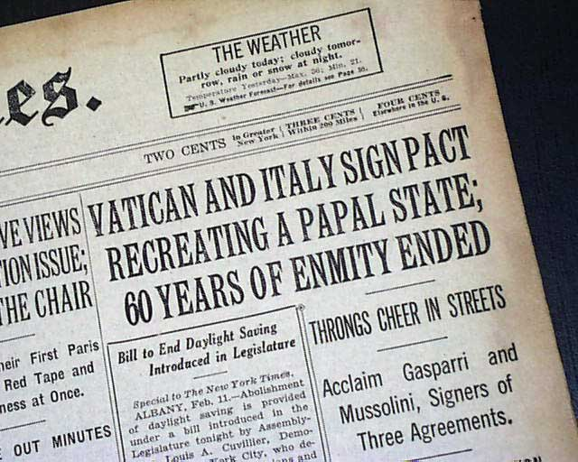
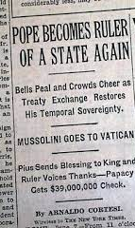
A Deadly Wound Healing: Feb. 11, 1929

Slide 9
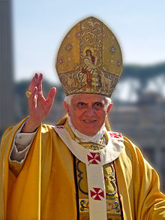
The Great Controversy p.563
The defenders of the papacy declare that the church has been maligned, and the Protestant world are inclined to accept the statement. Many urge that it is unjust to judge the church of today by the abominations and absurdities that marked her reign during the centuries of ignorance and darkness. They excuse her horrible cruelty as the result of the barbarism of the times and plead that the influence of modern civilization has changed her sentiments.

Slide 10
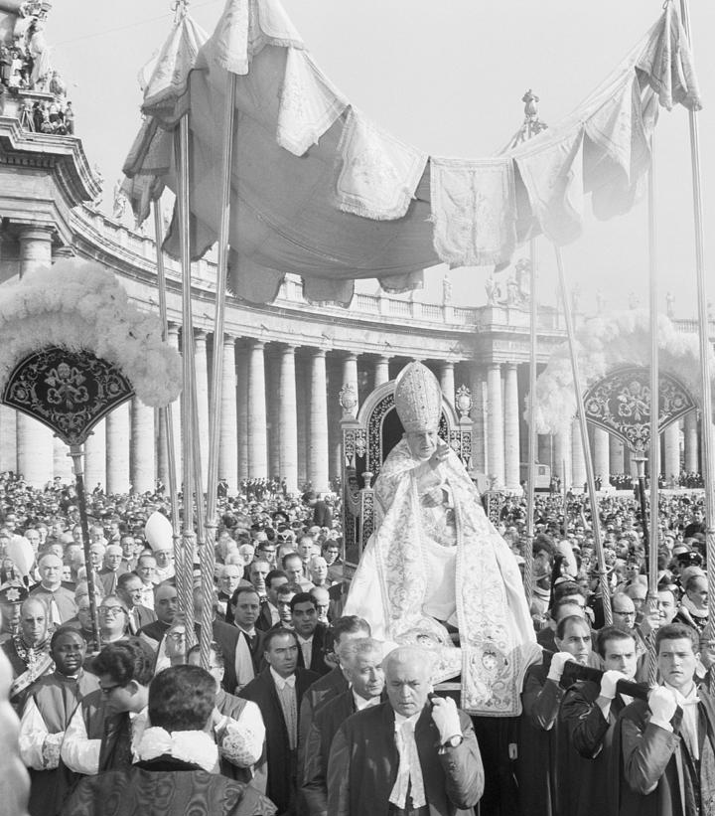
The Great Controversy p.564
Have these persons forgotten the claim of infallibility put forth for eight hundred years by this haughty power? So far from being relinquished, this claim was affirmed in the nineteenth century with greater positiveness than ever before. As Rome asserts that the “church never erred; nor will it, according to the Scriptures, ever err” (John L. von Mosheim, Institutes of Ecclesiastical History, book 3, century II, part 2, chapter 2, section 9, note 17), how can she renounce the principles which governed her course in past ages?

Slide 11
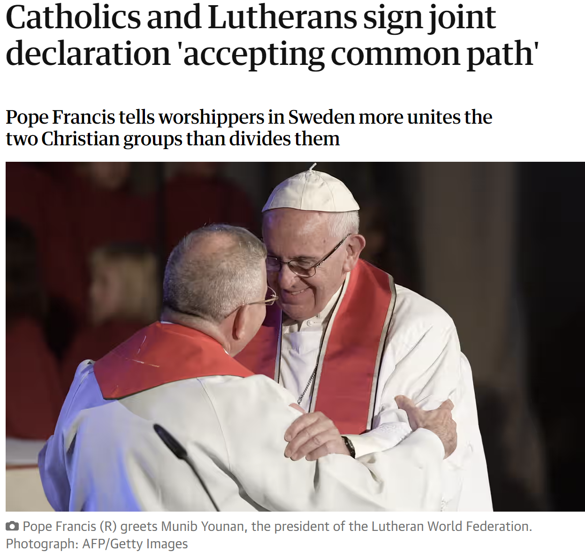
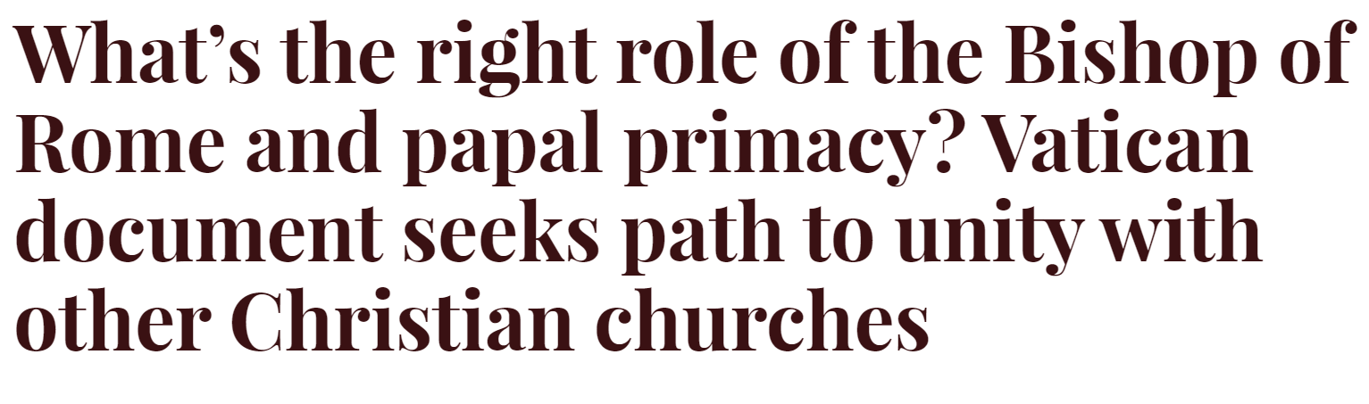
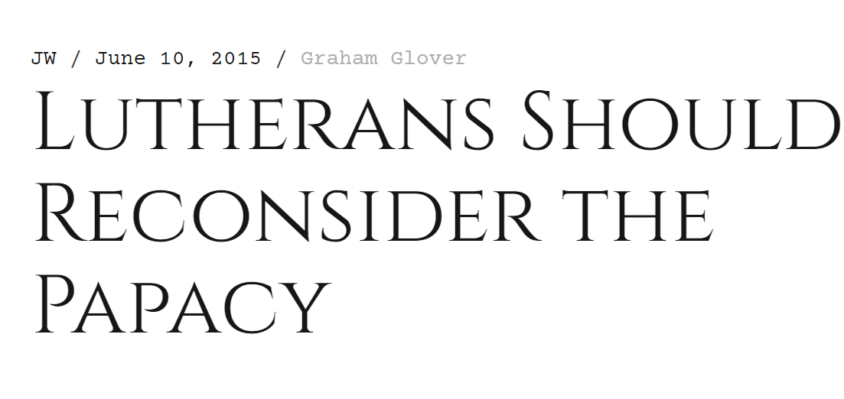
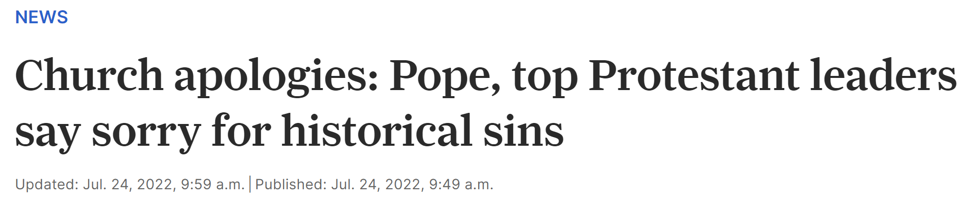
Christian Unity: A Deadly Wound Healing

Slide 12
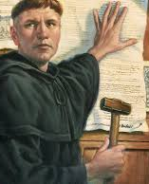
The Great Controversy p.571
It is not without reason that the claim has been put forth in Protestant countries that Catholicism differs less widely from Protestantism than in former times. There has been a change; but the change is not in the papacy. Catholicism indeed resembles much of the Protestantism that now exists, because Protestantism has so greatly degenerated since the days of the Reformers.

Slide 13
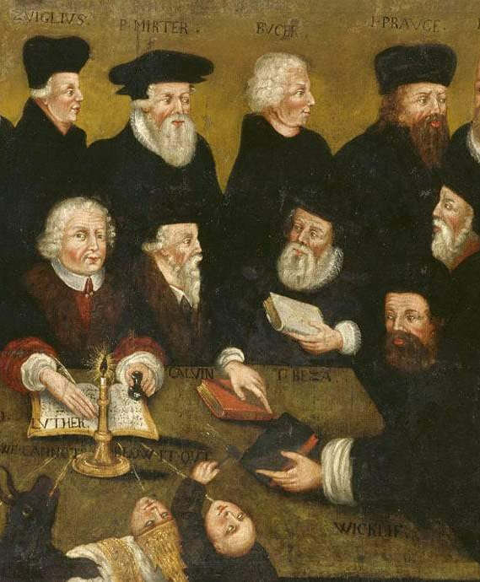
The Great Controversy p.571
As the Protestant churches have been seeking the favor of the world, false charity has blinded their eyes. They do not see but that it is right to believe good of all evil, and as the inevitable result they will finally believe evil of all good. Instead of standing in defense of the faith once delivered to the saints, they are now, as it were, apologizing to Rome for their uncharitable opinion of her, begging pardon for their bigotry.

Slide 14
a review: REVELATION 13:3-18
3 And I saw one of his heads as it were wounded to death; and his deadly wound was healed: and all the world wondered after the beast.

Slide 15
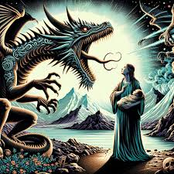
a review: REVELATION 13:4-18
4 And they worshipped the dragon which gave power unto the beast: and they worshipped the beast, saying, Who is like unto the beast? who is able to make war with him?

Slide 16
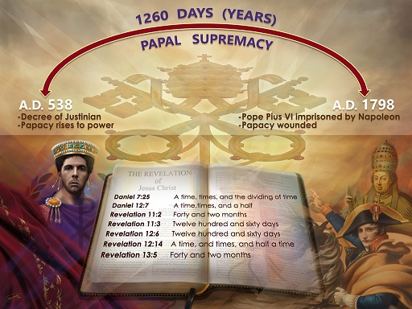
a review: REVELATION 13:5-18
5 And there was given unto him a mouth speaking great things and blasphemies; and power was given unto him to continue forty and two months.

Slide 17
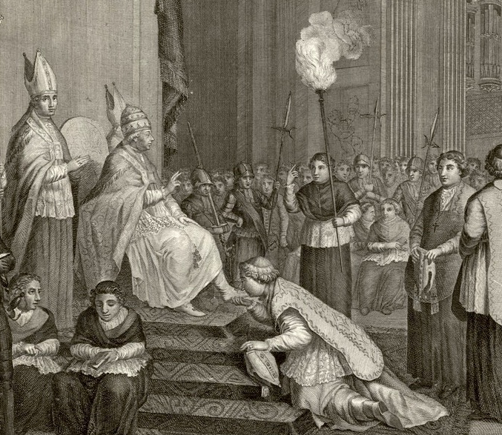
a review: REVELATION 13:6-18
6 And he opened his mouth in blasphemy against God, to blaspheme his name, and his tabernacle, and them that dwell in heaven.

Slide 18
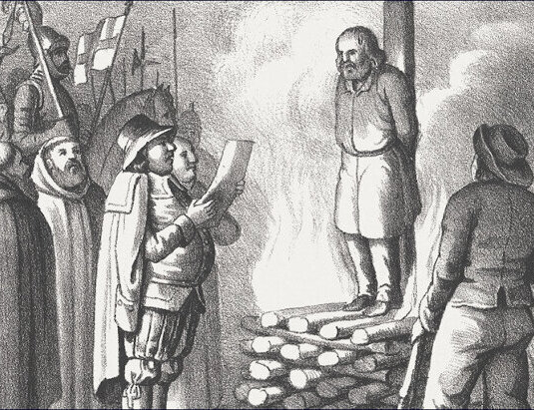
a review: REVELATION 13:7-18
7 And it was given unto him to make war with the saints, and to overcome them: and power was given him over all kindreds, and tongues, and nations.

Slide 19
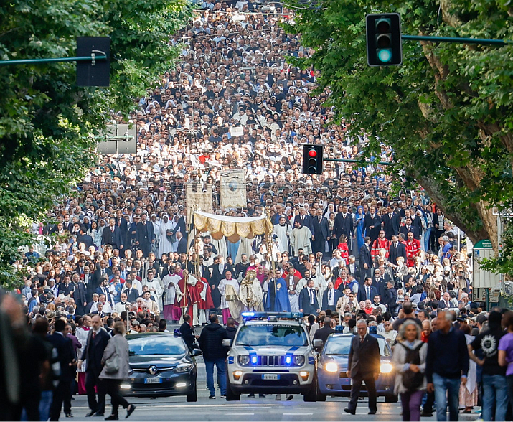
a review: REVELATION 13:8-18
8 And all that dwell upon the earth shall worship him, whose names are not written in the book of life of the Lamb slain from the foundation of the world.

Slide 20
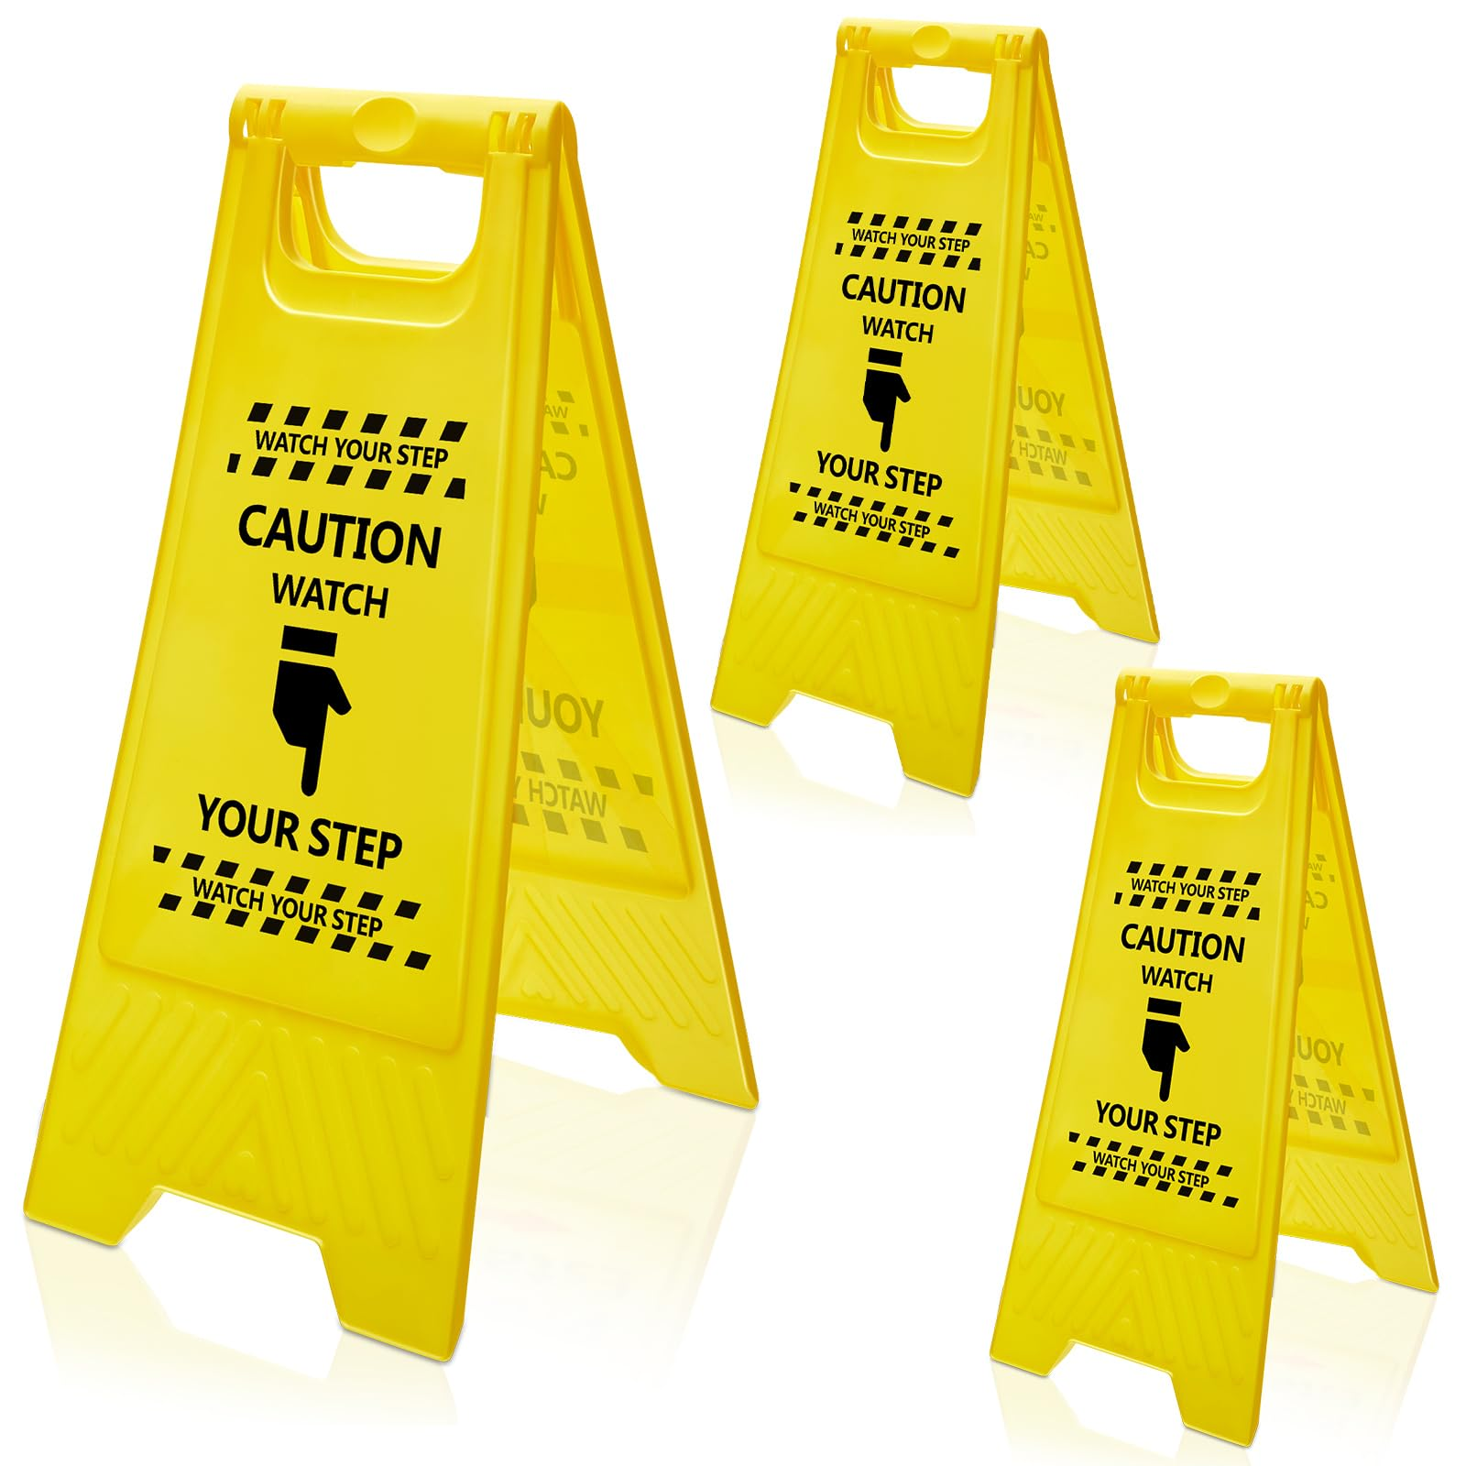
a review: REVELATION 13:9-18
9 If any man have an ear, let him hear.

Slide 21
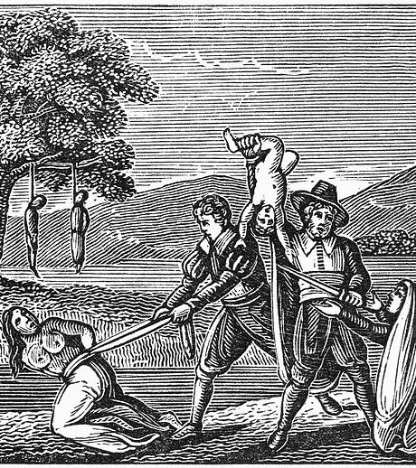
The Great Controversy p.573
If the reader would understand the agencies to be employed in the soon-coming contest, he has but to trace the record of the means which Rome employed for the same object in ages past. If he would know how papists and Protestants united will deal with those who reject their dogmas, let him see the spirit which Rome manifested toward the Sabbath and its defenders.

Slide 22
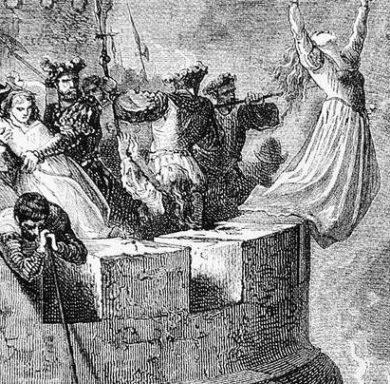
The Great Controversy p.578
These records of the past clearly reveal the enmity of Rome toward the true Sabbath and its defenders, and the means which she employs to honor the institution of her creating. The word of God teaches that these scenes are to be repeated as Roman Catholics and Protestants shall unite for the exaltation of the Sunday.

Slide 23
a little context: REVELATION 13:10-18
10 He that leadeth into captivity shall go into captivity: he that killeth with the sword must be killed with the sword. Here is the patience and the faith of the saints.
PATIENCE: hupomone in Greek, may be read “perseverance,” “fortitude,” “steadfast endurance.” Hupomone is from hupo, “under,” and mend, “to remain.” The Greek word implies more than a passive resignation; it denotes an active endurance . During the warfare of the beast the saints steadfastly endure.

Slide 24
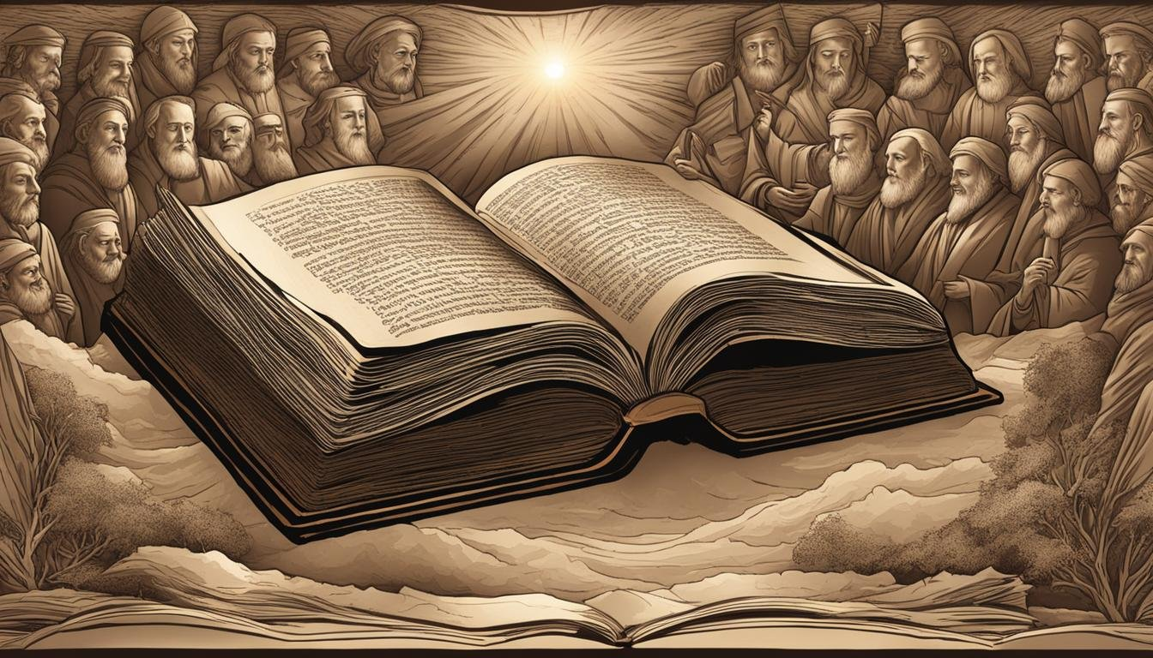
Therefore seeing we also are compassed about with so great a cloud of witnesses, let us lay aside every weight, and the sin which doth so easily beset us, and let us run with patience the race that is set before us, (Heb. 12:1)

Slide 25
a little context: REVELATION 13:11-18
11 And I beheld another beast coming up out of the earth; and he had two horns like a lamb, and he spake as a dragon.
Revelation’s symbology:
Earth—Sparsely populated territory
Lamb—Youthfulness, peaceful intent
Horns—Two notable features of the American system of government, civil and religious liberty, are guaranteed in the Constitution of the United States. Civil liberty found its expression in a republican form of government and religious liberty in Protestantism.

Slide 26
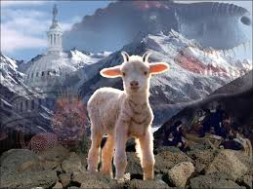
a little context: REVELATION 13:11-18
11 And I beheld another beast coming up out of the earth; and he had two horns like a lamb, and he spake as a dragon.

Slide 27
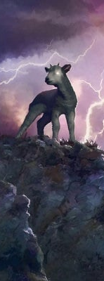
a little context: REVELATION 13:11-18
There is a striking contradiction between the appearance and actions of the beast. In appearance it is gentle and apparently harmless, but in action it is persecuting and cruel, as vs. 12-18 reveal. When the prophecy is applied to the United States it is immediately apparent that fulfillment of the prediction is future. The United States today continues to largely maintain the principles of freedom guaranteed in the Constitution. The manner in which a change in policy will be brought about is outlined in the present prophecy. The change comes in connection with the final crisis immediately preceding the time when “the kingdoms of this world . . . become the kingdoms of our Lord, and of his Christ”.

Slide 28
a little context: REVELATION 13:12-18
12 And he exerciseth all the power of the first beast before him, and causeth the earth and them which dwell therein to worship the first beast, whose deadly wound was healed.
During the height of its power the first beast, the papacy, exercised widespread authority in both religious and political matters. For the second beast to exercise ALL the authority of the first beast, it will have to enter the field of religion, and seek to dominate religious worship. For the United States to take this step will mean a complete reversal of its present policy of granting full freedom of religion to its citizens. Such a step is here predicted.

Slide 29
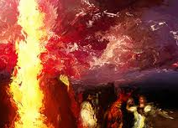
a little context: REVELATION 13:13-18
13 And he doeth great wonders, so that he maketh fire come down from heaven on the earth in the sight of men,

Slide 30
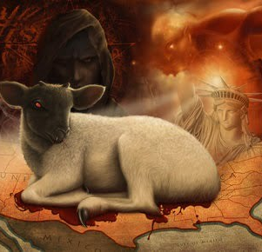
a little context: REVELATION 13:14-18
14 And deceiveth them that dwell on the earth by the means of those miracles which he had power to do in the sight of the beast; saying to them that dwell on the earth, that they should make an image to the beast, which had the wound by a sword, and did live.

Slide 31
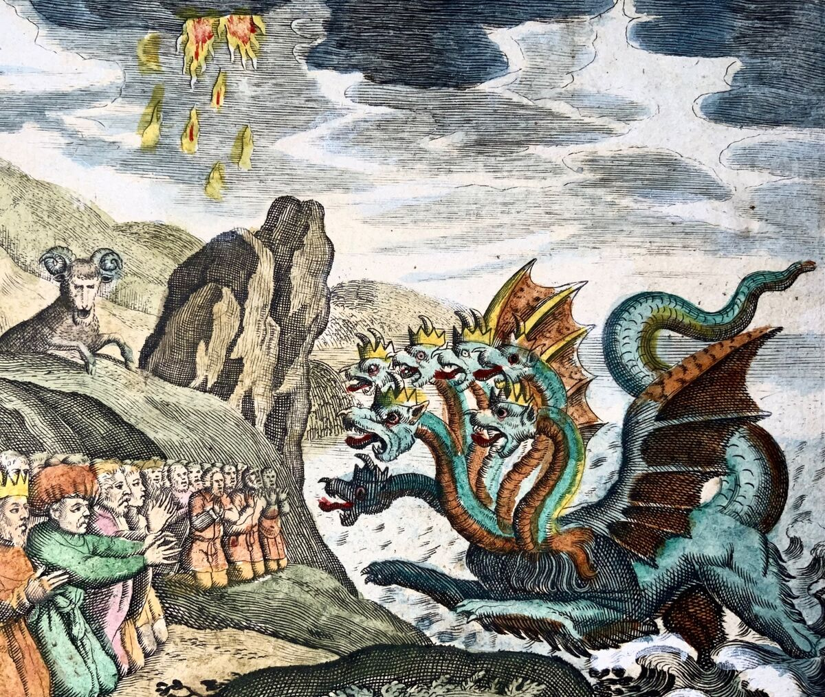
a little context: REVELATION 13:15-18
15 And he had power to give life unto the image of the beast, that the image of the beast should both speak, and cause that as many as would not worship the image of the beast should be killed.

Slide 32
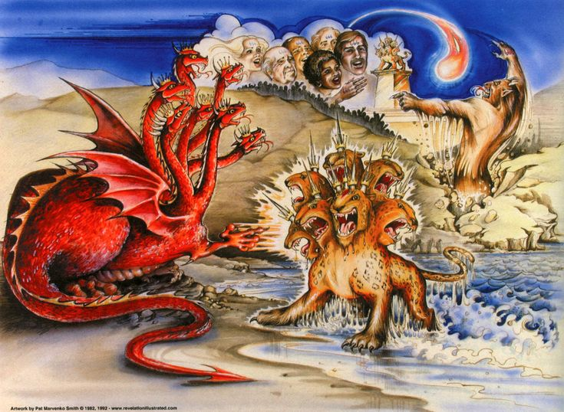
a little context: REVELATION 13:15-18
This is the story of the ages. Legislation in matters of religion has ever been followed by persecution. In its attempt to make all earth’s inhabitants give allegiance to the first beast the second beast will issue a decree threatening with death all who maintain their loyalty to God.

Slide 33
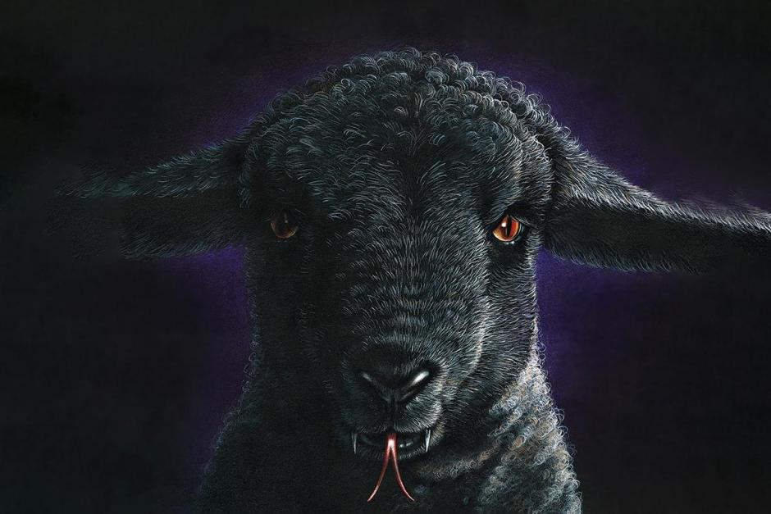
The Opposition
Dragon
01
Beast with the deadly wound that healed
02
Image of the Beast (under the auspices of the lamb-like beast)

Slide 34
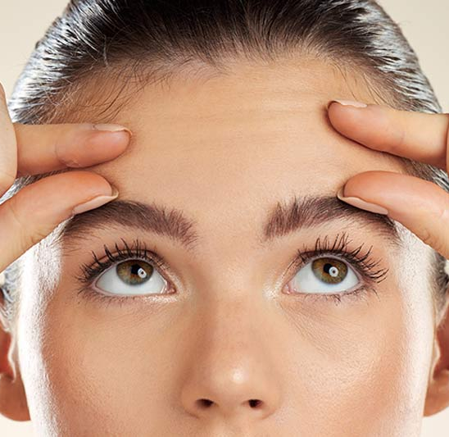
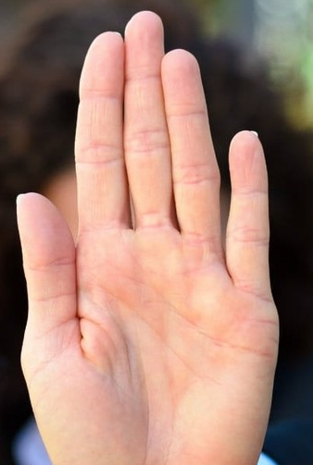
a little context: REVELATION 13:16-18
16 And he causeth all, both small and great, rich and poor, free and bond, to receive a mark in their right hand, or in their foreheads:
Ideas/ Beliefs
Actions/Works

Slide 35

a little context: REVELATION 13:17-18
17 And that no man might buy or sell, save he that had the mark, or the name of the beast, or the number of his name.

Slide 36
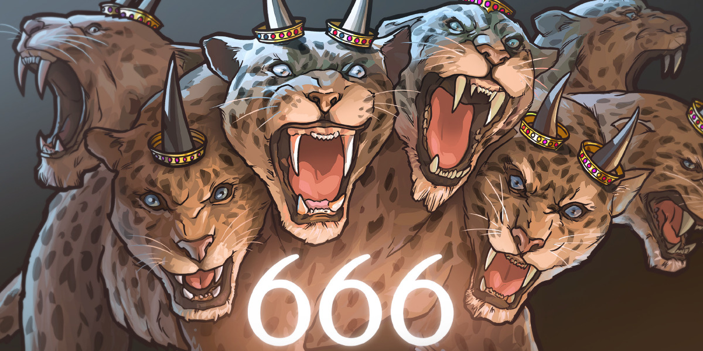
a little context: REVELATION 13:18
18 Here is wisdom. Let him that hath understanding count the number of the beast: for it is the number of a man; and his number is Six hundred threescore and six.
It should be noted that the beast has already been conclusively identified. The number provides confirmatory evidence of this.

Slide 37
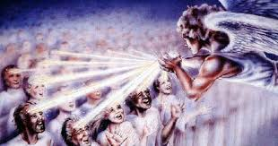
messages: REVELATION 14:1-12
14 And I looked, and, lo, a Lamb stood on the mount Sion, and with him an hundred forty and four thousand, having his Father's name written in their foreheads.
In Rev. 7:3 the 144,000 are said to be sealed “in their foreheads.” There is, therefore, a close connection between the seal and the divine name!

Slide 38
² And I saw another angel ascending from the east, having the seal of the living God: and he cried with a loud voice to the four angels, to whom it was given to hurt the earth and the sea,
³ Saying, Hurt not the earth, neither the sea, nor the trees, till we have sealed the servants of our God in their foreheads.
⁴ And I heard the number of them which were sealed: and there were sealed an hundred and forty and four thousand of all the tribes of the children of Israel.
Daniel 7:2-4

Slide 39
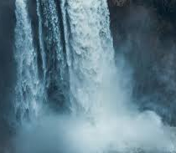
messages: REVELATION 14:2-12
2 And I heard a voice from heaven, as the voice of many waters, and as the voice of a great thunder: and I heard the voice of harpers harping with their harps:

Slide 40
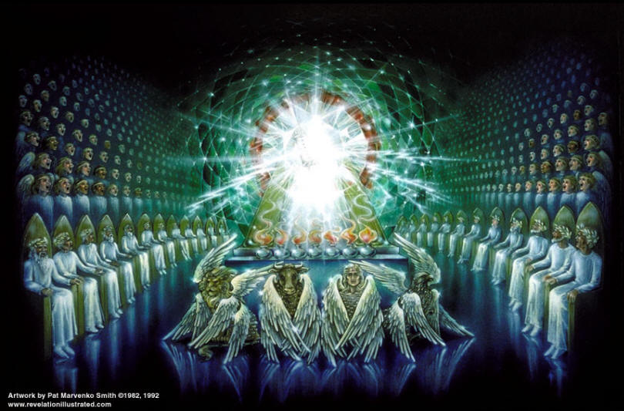
messages: REVELATION 14:3-12
3 And they sung as it were a new song before the throne, and before the four beasts, and the elders: and no man could learn that song but the hundred and forty and four thousand, which were redeemed from the earth.
The throne, beasts, and elders are described back in Revelation 4!

Slide 41
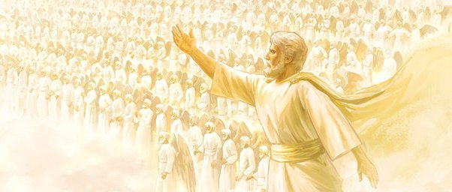
messages: REVELATION 14:4-12
4 These are they which were not defiled with women; for they are virgins. These are they which follow the Lamb whithersoever he goeth. These were redeemed from among men, being the firstfruits unto God and to the Lamb.
The 144,000 are “virgins” because they have not been consorting with any of the apostate religious philosophies represented by Babylon or her daughters.

Slide 42
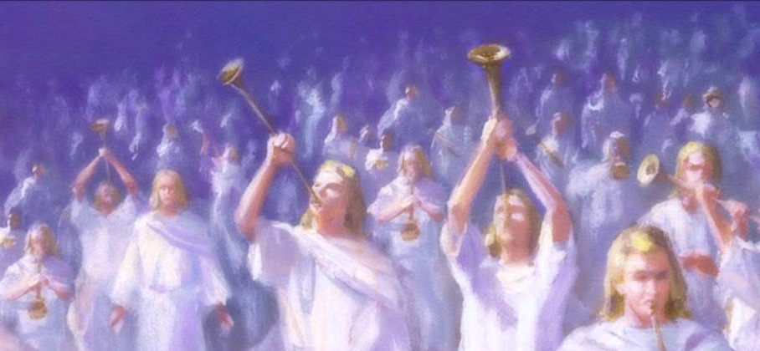
messages: REVELATION 14:5-12
5 And in their mouth was found no guile: for they are without fault before the throne of God.
The form of the Greek verb suggests that a certain point of time is under consideration. At that point of time investigation proves the 144,000 to be faultless. This does not mean that they had never erred, but that by the grace of God they had overcome all defects of character.

Slide 43
messages: REVELATION 14:6-12
6 And I saw another angel fly in the midst of heaven, having the everlasting gospel to preach unto them that dwell on the earth, and to every nation, and kindred, and tongue, and people,
This is a symbolic vision. The angel represents God’s saints engaged in the task of proclaiming the everlasting gospel, especially the features mentioned in this verse, at a time when the “judgment is come” (v. 7).
A new scene begins. Chronologically the events represented in this vision precede those represented by the vision of vs. 1-5.

Slide 44
messages: REVELATION 14:6-12
6 And I saw another angel fly in the midst of heaven, having the everlasting gospel to preach unto them that dwell on the earth, and to every nation, and kindred, and tongue, and people,
This is a symbolic vision. The angel represents God’s saints engaged in the task of proclaiming the everlasting gospel, especially the features mentioned in this verse, at a time when the “judgment is come” (v. 7).

Slide 45
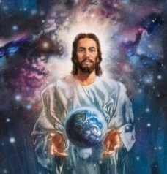
messages: REVELATION 14:7-12
7 Saying with a loud voice, Fear God, and give glory to him; for the hour of his judgment is come: and worship him that made heaven, and earth, and the sea, and the fountains of waters.

Slide 46
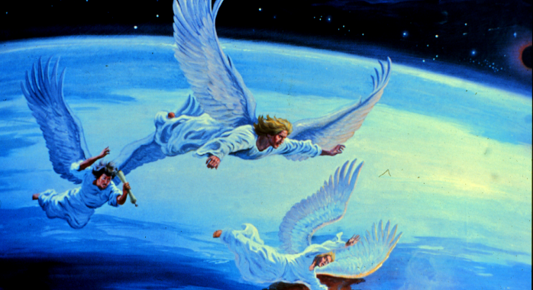
FEAR GOD: his means we should revere God and look upon Him with love, trust, and respect—eager to do His bidding. This keeps us from evil. “By the fear of the Lord one departs from evil” (Proverbs 16:6). Solomon, the wise man, also said, “Fear God and keep His commandments, for this is man’s all [whole duty]” (Ecclesiastes 12:13).

Slide 47
GIVE GLORY TO GOD: We fulfill this command when we praise, thank, and obey God for His goodness to us. One of the major sins of the last days is unthankfulness (2 Timothy 3:1, 2).

Slide 48
THE HOUR OF HIS JUDGMENT IS COME: This indicates that everyone is accountable to God, and it is a clear statement that the judgment is now in session. A number of translations say “has” come instead of “is” come.

Slide 49
WORSHIP THE CREATOR: This command rejects idolatry of all kinds—including self-worship—and repudiates the theory of evolution, which denies that God is Creator and Redeemer. (Many books and talk shows stress self-esteem, which can lead to self-worship. Christians find their value in Christ, who makes us sons and daughters of God.)

Slide 50
messages: REVELATION 14:7-12
The gospel includes the creation and redemption of the world by the Lord God. Worshiping the Creator includes worshiping Him on the day He set aside as a memorial of Creation (the seventh-day Sabbath). That Revelation 14:7 refers to the seventh-day Sabbath is made clear by the fact that the words “made heaven and earth, the sea” were lifted right out of the Sabbath commandment and used here. Our roots are found in God alone, who made us in His image in the beginning. Those who do not worship God as Creator—no matter what else they might worship—will never discover their roots.
7 Saying with a loud voice, Fear God, and give glory to him; for the hour of his judgment is come: and worship him that made heaven, and earth, and the sea, and the fountains of waters.

Slide 51
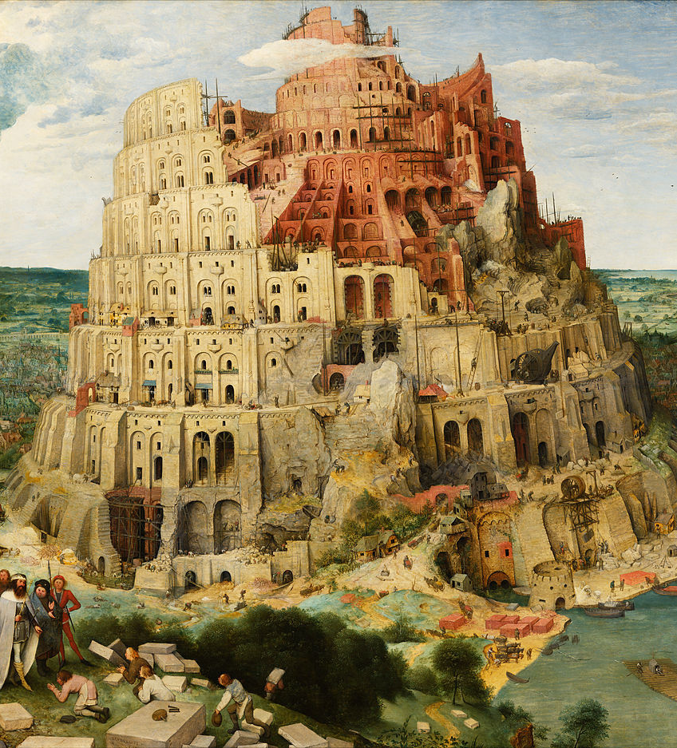
messages: REVELATION 14:8-12
8 And there followed another angel, saying, Babylon is fallen, is fallen, that great city, because she made all nations drink of the wine of the wrath of her fornication.

Slide 52
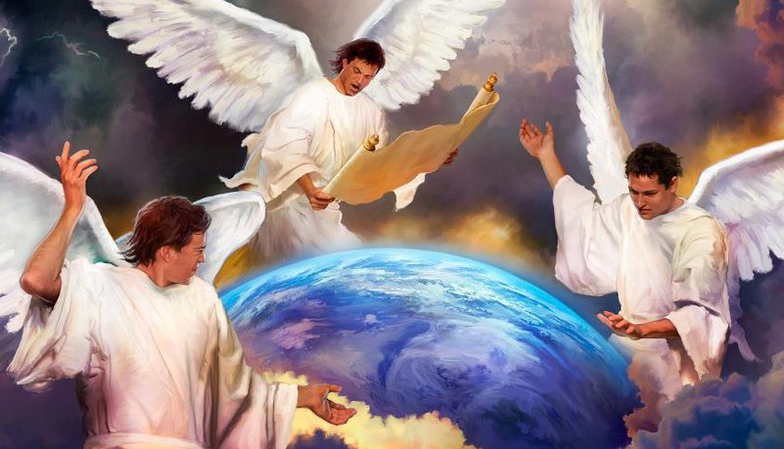
BABYLON IS FALLEN: Babylon, both literal and spiritual, has long been recognized as the traditional enemy of God’s truth and people. As used in the Revelation the name is symbolic of all apostate religious organizations and their leadership, from antiquity down to the close of time . The power which “thought to change times and laws” is fallen and must be rejected in favor of honor to the true laws of our Creator.

Slide 53
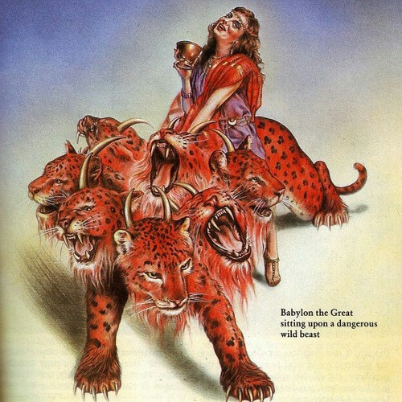
messages: REVELATION 14:9-12
9 And the third angel followed them, saying with a loud voice, If any man worship the beast and his image, and receive his mark in his forehead, or in his hand,

Slide 54
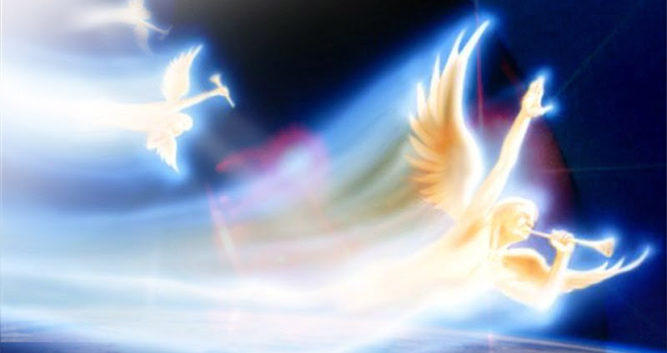
HIS MARK: This is evidently some badge of loyalty to the beast, some special feature that denotes that the one displaying such a mark worships the first beast, whose deadly wound was healed. The controversy at that time will center on the law of God, and particularly on the fourth commandment. This mark being in the hand or in the forehead may indicate that not only one’s labor (the hand) but also one’s belief is affected.

Slide 55
THE BEAST AND HIS IMAGE: The beast and the image are united in their aims and policies and in their demand that men receive the mark of the beast. Hence, one who worships the beast also worships the image and is a bearer of the mark.

Slide 56
The third angel’s message warns people against worshiping the beast and his image and receiving the mark of the beast in their forehead or hand. The first angel commands true worship. The third angel tells of the tragic consequences connected with false worship.

Slide 57
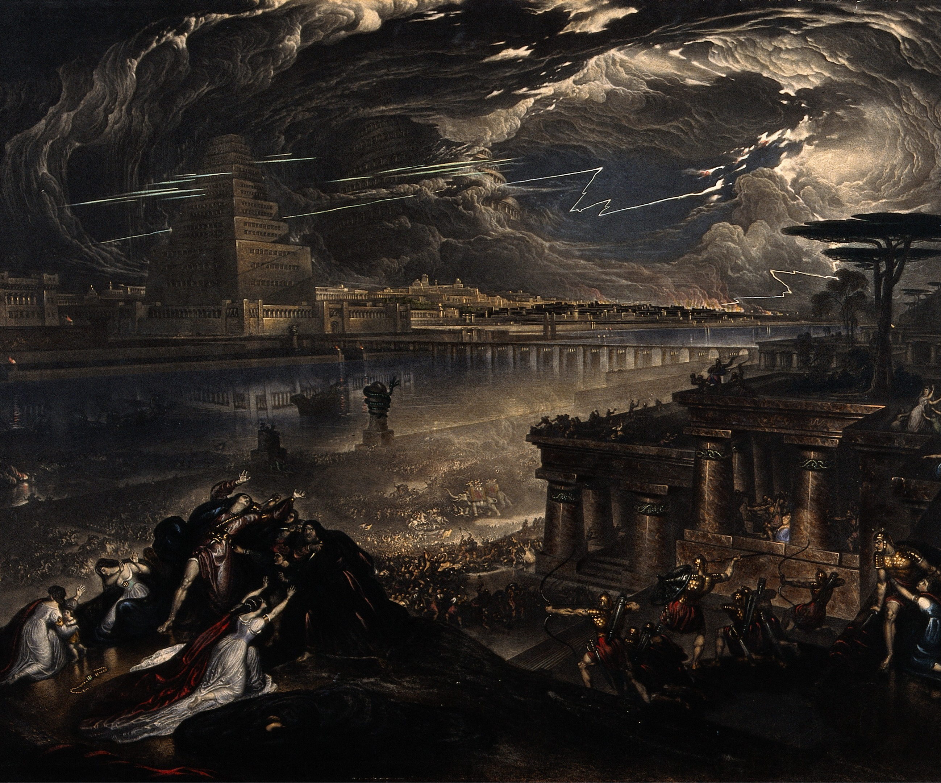
messages: REVELATION 14:10-12
10 The same shall drink of the wine of the wrath of God, which is poured out without mixture into the cup of his indignation; and he shall be tormented with fire and brimstone in the presence of the holy angels, and in the presence of the Lamb:

Slide 58
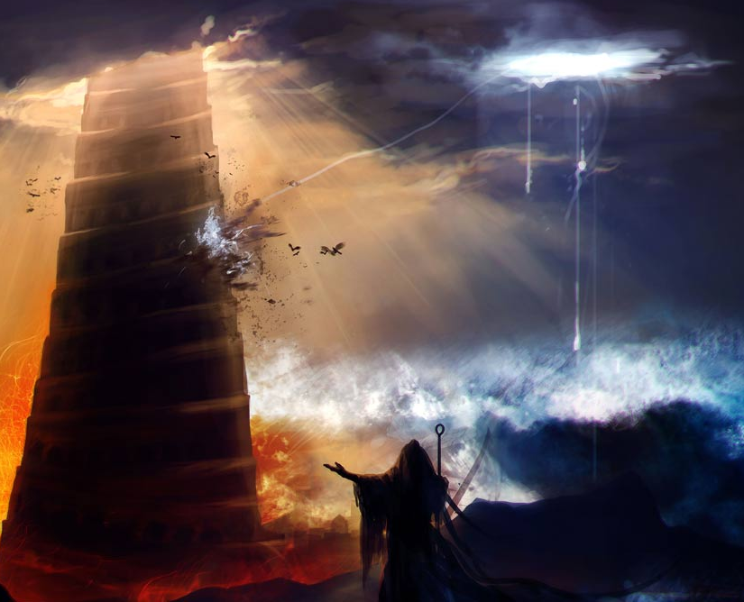
messages: REVELATION 14:11-12
11 And the smoke of their torment ascendeth up for ever and ever: and they have no rest day nor night, who worship the beast and his image, and whosoever receiveth the mark of his name.

Slide 59
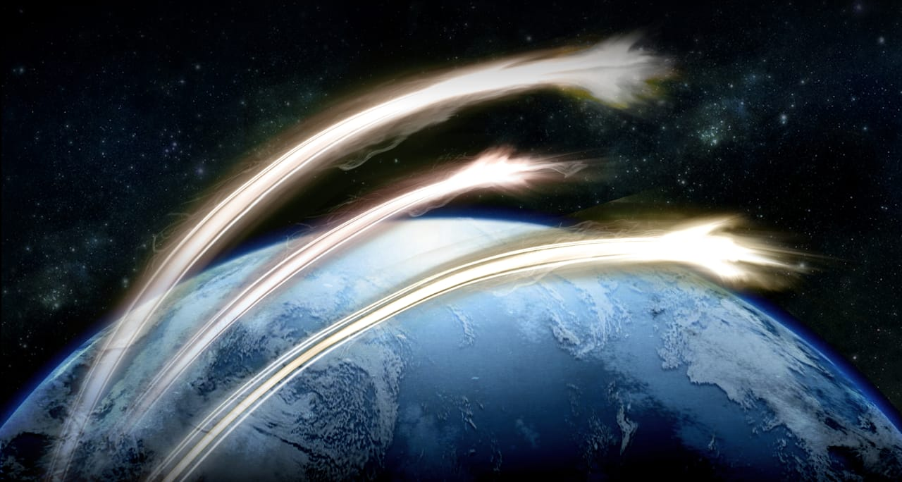
The third angel utters a most fearful threat. The inhabitants of earth will be without excuse if they do not escape the entanglement here warned against. They should put forth every effort to discover the identity of the beast, his image, and mark, and to become acquainted with his wiles and policies.

Slide 60
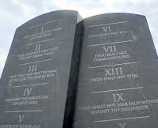
messages: REVELATION 14:12
12 Here is the patience of the saints: here are they that keep the commandments of God, and the faith of Jesus.

Slide 61
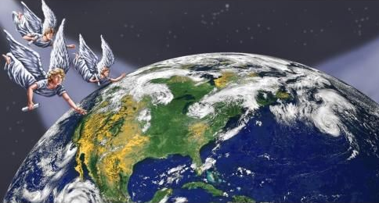
WHO ARE THESE?:
They are patient, persevering, and faithful to the end. God’s people reveal Him by their patient, loving conduct and by their faithfulness to holiness in their lives.
They are saints, or “holy ones,” because they are fully on God’s side.

Slide 62
WHO ARE THESE?:
They keep the commandments of God. These faithful people happily obey His Ten Commandments and all other commandments He has given. Their first aim is to please Him, whom they love (1 John 3:22).

Slide 63
WHO ARE THESE?:
They have the faith of Jesus. This also can be translated “faith in Jesus.” In either case, God’s people fully follow Jesus and fully trust Him.

Slide 64
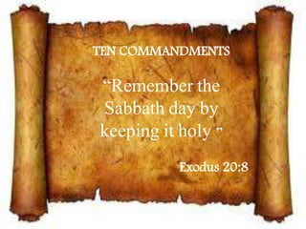
SDA Commentary
“Once again the translation “steadfast endurance” would be a more suitable rendering. The context calls attention to the fearful struggle with the beast and his image. Every attempt will be made to force the remnant to join the movement promoted by the second beast, including the threat of boycott and death. At the same time Satan will work with all “deceivableness of unrighteousness” (2 Thess. 2:10), making it appear that the power of God is manifest in the movement. Through all this the faithful remnant steadfastly endure and maintain their integrity. Their steadfastness merits special commendation.”

Slide 65
Happy sabbath!
Thank you!!

